Slide 1
Acoustic Analysis Dashboard
Visualizing data via acoustic metrics for detailed insights
Notes:
AI-generated content may be incorrect. ---

Slide 2
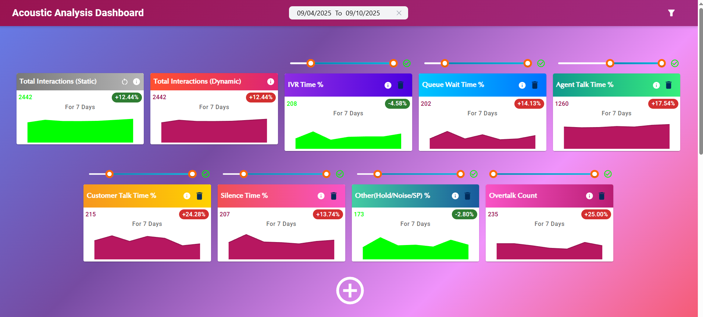
Introduction
Notes:
Professional Introduction with Tech Stack

Slide 3

Tech Stack
Full-Stack Application
The dashboard uses a full-stack approach combining frontend, backend, and database technologies for comprehensive data analysis.
Modern Tech Stack
Technologies used include React for frontend, Node.js for backend, and MySQL Database for efficient data storage.
User-Centric Design
The dashboard features a professional design focused on ease of use and high functionality for business users.
Seamless Data Integration
Integration with Genesys Cloud APIs ensures accurate historical and real-time acoustic data retrieval and visualization.
Notes:
The Acoustic Analysis Dashboard is a full-stack application designed to provide comprehensive insights into Genesys Cloud contact center data. Built using modern technologies including React for the frontend, Node.js for the backend, and MySQL for data storage, this dashboard offers a robust and scalable solution for acoustic data analysis. The dashboard is tailored to meet the needs of business analysts and contact center managers by delivering real-time metrics and interactive visualizations. Its minimalistic and professional design ensures ease of use while maintaining high functionality. The tech stack enables seamless integration with Genesys Cloud APIs, ensuring accurate and timely data retrieval. This introductory slide sets the stage for a deep dive into the dashboard’s features and business impact.

Slide 4
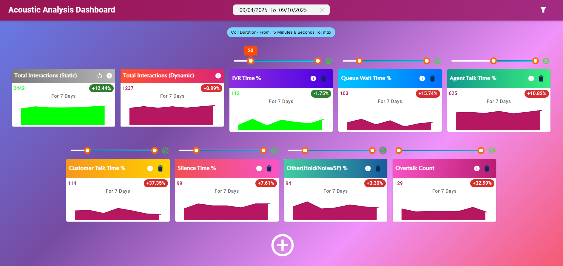
Statistical Cards
Notes:
Real-time Metrics Explanation, Advanced Features and Metric Types

Slide 5

Real-time Metrics Explanation
Comprehensive Acoustic Metrics
The dashboard tracks data points including interaction counts and key acoustic metrics, providing broad performance insights.
Trend Visualization
Color-coded arrows on cards indicate upward or downward trends, enabling quick performance assessment.
Interval-based Data Display
Metrics are shown for selected intervals, typically a 7-day period, for timely and relevant performance tracking.
Operational Monitoring Tool
The designed dashboard supports strategic planning by offering an intuitive snapshot of key performance indicators.
Notes:
The dashboard features statistical cards that provide real-time metrics for various acoustic data points. These include Total Interactions, IVR Time %, Queue Wait Time %, Agent Talk Time %, Customer Talk Time %, Silence Time %, and Overtalk Count %. Each card displays values for a selected interval, typically a 7-day period, and includes visual indicators such as color-coded arrows to denote trends. This allows users to quickly assess performance and identify areas needing attention. The cards are designed to be intuitive and informative, offering a snapshot of key metrics at a glance. This feature is essential for operational monitoring and strategic planning.

Slide 6
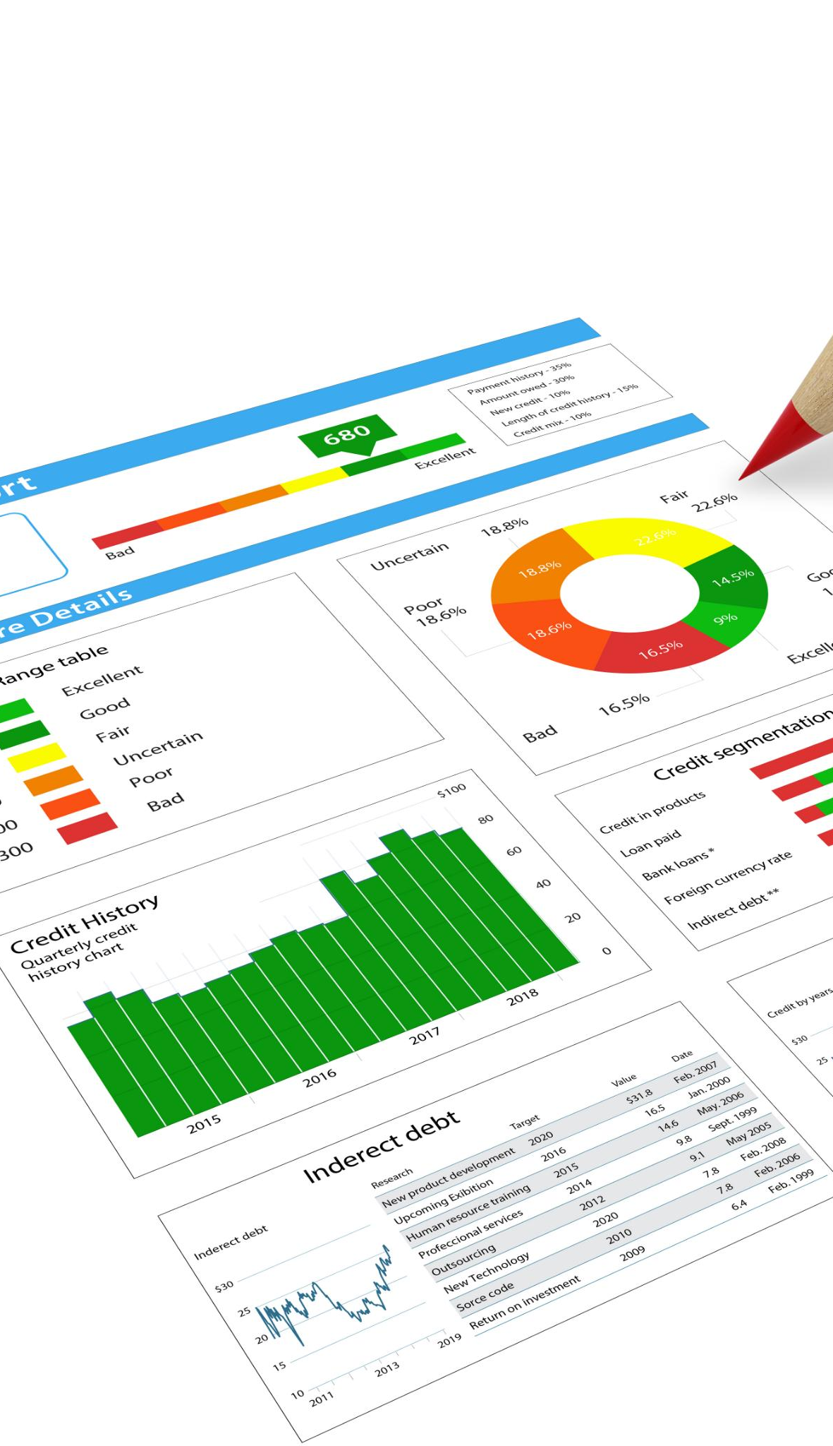
Advanced Features and Metric Types
Trend Tracking Features
Statistical cards show percentage changes and daily breakdowns to track trends and fluctuations in data.
Insightful Acoustic Metrics
Metrics like silence time and overtalk count help investigate unusual acoustic behavior effectively.
Dynamic User Filters
User-selected filters dynamically update data to keep analysis relevant and contextual.
Customizable view
Users can remove/add the cards they want in the dashboard view .
Notes:
Beyond basic metrics, the statistical cards incorporate advanced features such as percentage change compared to previous intervals and day-by-day breakdowns. This enables users to track trends over time and understand fluctuations in acoustic data. For example, a sudden increase in silence time or overtalk count can be investigated further using these insights. The cards also support dynamic updates based on user-selected filters, ensuring that the data remains relevant and contextual. These technical enhancements make the dashboard a powerful tool for detailed analysis and decision-making.

Slide 7
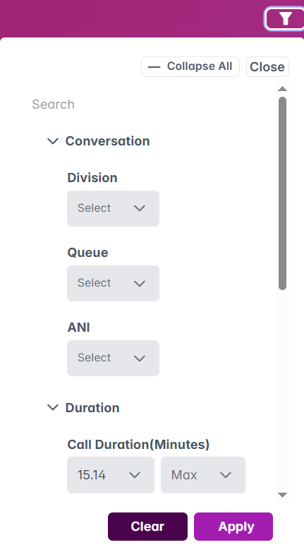
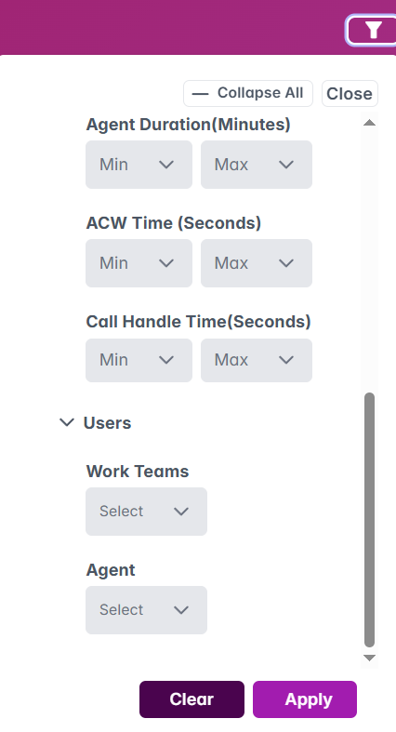
Global Pre-Filters
Notes:
Unified Data Control System, Enhanced Filtering Capabilities

Slide 8
Unified Data Control System
Global Pre-Filters Functionality
Users can filter data across all dashboard components using multiple key-value pairs such as Division, Queue, ANI, Agent Name, etc.
Consistency Across Visualizations
The unified system ensures all metrics and charts reflect the filtered data consistently and accurately.
Multiple Filters Application
Users can apply several filters simultaneously to narrow data for targeted and granular analysis.
Notes:
The Global Pre-Filters feature allows users to filter data across all components of the dashboard using key-value pairs (KVPs). Filters include Division, Queue, ANI, Call Duration, Agent Duration, ACW Time, Handle Time, Work Teams, and Agent selection. This unified control system ensures that all visualizations and metrics reflect the filtered dataset, providing consistency and accuracy. Users can apply multiple filters simultaneously to narrow down the data to specific segments. This capability is crucial for targeted analysis and enhances the dashboard’s usability by offering granular control over the displayed information.

Slide 9
Enhanced Filtering Capabilities
Advanced Filter Options
The dashboard provides range-based and categorical filters for precise data segmentation and analysis.
Real-Time Updates
Filters update all dashboard components instantly to provide a synchronized analytical experience.
User-Friendly Interface
Filters use intuitive dropdowns and sliders designed for easy and efficient selection by users.
In-Depth Data Insights
Enhanced filtering empowers users to derive actionable insights from detailed data subsets.
Notes:
In addition to basic filtering, the dashboard supports advanced filtering options that allow users to segment data with precision. These include range-based filters for durations and categorical filters for divisions and queues. The filters are designed to be user-friendly, with dropdowns and sliders for easy selection. Once applied, the filters update all dashboard components in real-time, ensuring a cohesive analytical experience. This feature empowers users to conduct in-depth investigations and derive actionable insights from specific subsets of data.

Slide 10
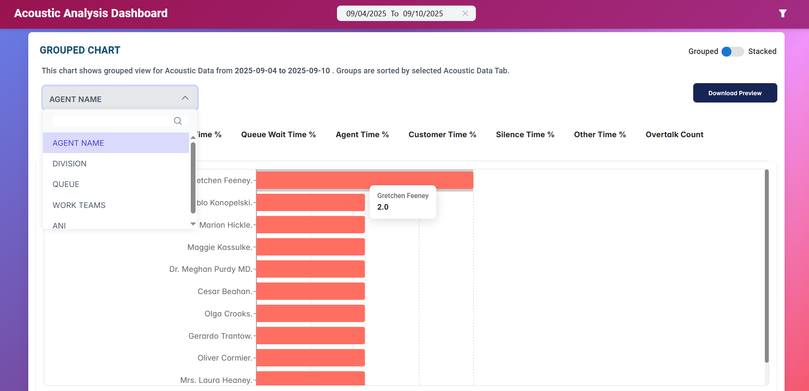
Grouped Bar Chart
Notes:
Comparative Analysis Capabilities, Advanced Analytics and Planned Enhancements

Slide 11

Comparative Analysis Capabilities
Grouped Bar Chart Overview
Displays conversation data combined with acoustic metrics, which can be grouped by Agent, Division, or Queue for clear comparative analysis.
Comparison Across Entities
Allows side-by-side comparison of various metrics to identify performance differences between groups.
Interactive Sorting and Tabs
Supports sorting and tab selection to focus analysis on specific data points efficiently.
Performance Disparity Insights
Helps identify disparities in performance and understand contributions of different segments.
Notes:
The Grouped Bar Chart provides a visual representation of acoustic data grouped by Agent Name, Division, or Queue. This enables users to perform comparative analysis across different entities and time intervals. Each group displays multiple bars representing various metrics, allowing for side-by-side comparison. The chart supports sorting and tab-based selection, making it easy to focus on specific data points. This visualization is particularly useful for identifying performance disparities and understanding how different segments contribute to overall metrics.

Slide 12

Advanced Analytics and Planned Enhancements
Dynamic Grouping and Drill-Down
Dynamic grouping allows users to explore detailed data by drilling down into specific categories or periods.
Customization of Groupings
Future enhancements will enable users to customize groupings for tailored analytical insights and flexibility.
Predictive Analytics Integration
Integrating predictive analytics will help forecast trends, supporting strategic decision-making with data-driven insights.
Notes:
The Grouped Bar Chart is equipped with advanced analytics features such as dynamic grouping and drill-down capabilities. Users can interact with the chart to explore deeper levels of data, such as individual conversations or specific time periods. Planned enhancements include the ability to customize groupings and integrate predictive analytics for trend forecasting. These features aim to provide a more comprehensive analytical experience and support strategic decision-making. The chart’s flexibility and depth make it a valuable tool for both operational and strategic analysis.

Slide 13
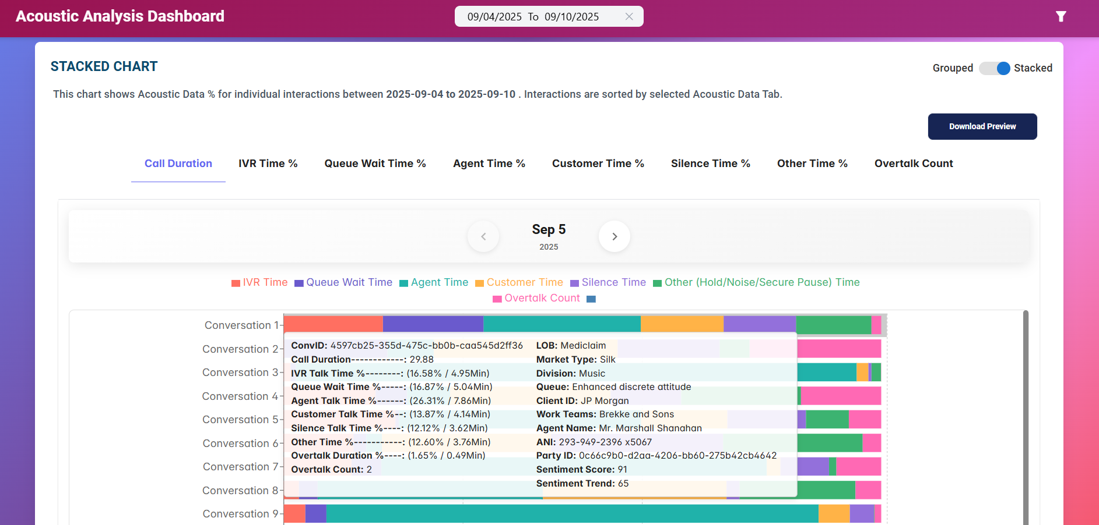
Stacked Bar Chart
Notes:
Conversation Composition Visualization, Granular Intelligence Features

Slide 14
Conversation Composition Visualization
Visualization of Acoustic Data
Stacked bar chart represents acoustic data as percentage segments of total call duration for easy analysis.
Conversation Structure Insights
Chart segments reveal conversation patterns by showing silence, agent, and customer talk durations clearly.
Interactive Data Exploration
Hover-over interactivity provides detailed information about each conversation segment for in-depth evaluation.
Call Quality Evaluation
This visualization helps identify areas for improvement by highlighting key acoustic metrics during calls.
Notes:
The Stacked Bar Chart visualizes acoustic data as a percentage of total call duration, providing insights into conversation composition. Each bar is divided into segments representing different acoustic metrics such as silence time, agent talk time, and customer talk time. This format allows users to understand how conversations are structured and identify patterns. The chart is interactive, with hover-over details that display additional information about each segment. This visualization is essential for evaluating call quality and identifying areas for improvement.

Slide 15

Granular Intelligence Features
Detailed Metrics on Hover
Users can hover over chart segments to view specific metrics like duration and percentage contribution, enhancing insight.
Supports Filtering and Updates
Dynamic filtering and updates keep data relevant and tailored, improving real-time data analysis.
Enables Root Cause Analysis
Granular data insight facilitates root cause analysis of calls, aiding in operational optimization.
Notes:
The Stacked Bar Chart includes features that provide granular intelligence for each conversation. Users can hover over any segment to view detailed metrics such as duration and percentage contribution. This enables a deeper understanding of individual calls and supports root cause analysis. The chart also supports filtering and dynamic updates, ensuring that the data remains relevant. These features make the chart a powerful tool for detailed acoustic analysis and operational optimization.

Slide 16
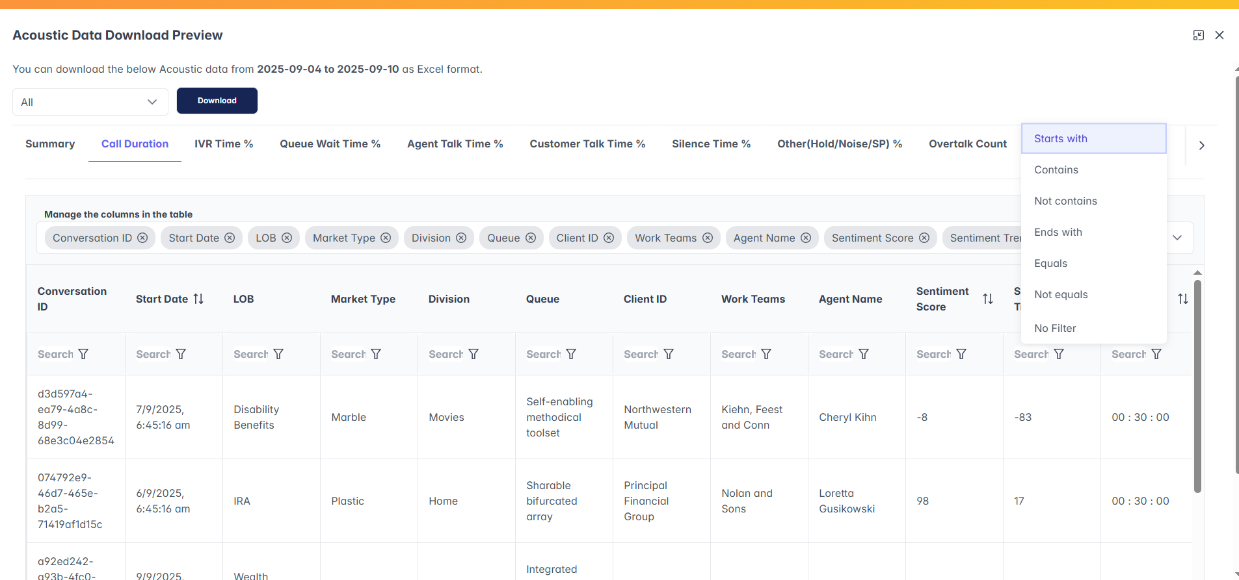
Download Preview & Export
Notes:
Comprehensive Data Extraction Capabilities

Slide 17
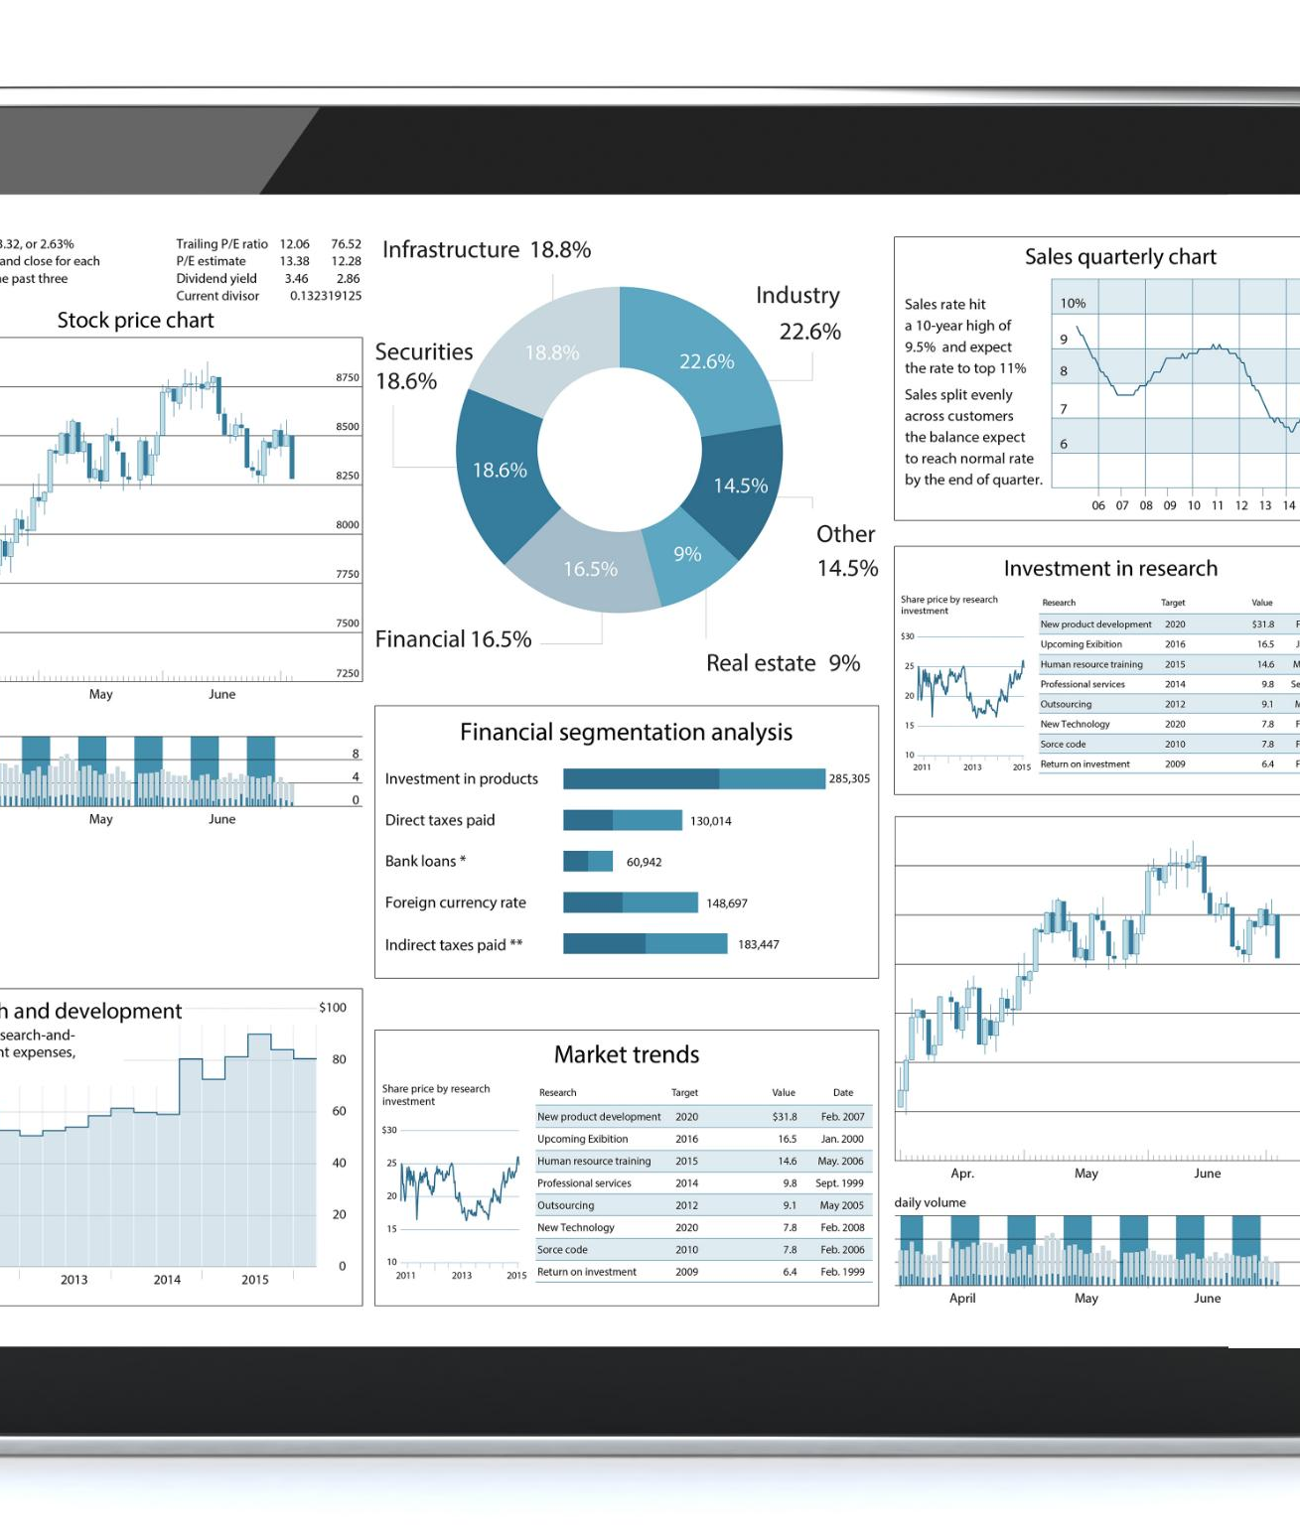
Comprehensive Data Extraction Capabilities
Download Preview Feature
Users can preview detailed conversation metrics before exporting data for better analysis.
Exporting Data to Excel
Export functionality supports Excel files with multiple tabs and column filters for customized output.
Enhanced Reporting and Sharing
The feature improves reporting capabilities and facilitates easy data sharing outside the dashboard.
Notes:
The dashboard includes a Download Preview feature that allows users to view detailed conversation metrics and export them as Excel files. Each chart has a corresponding preview tab where users can explore the underlying data. The export functionality supports multiple tabs and column filters, enabling users to customize the output. This feature is essential for reporting and further analysis outside the dashboard. It enhances the dashboard’s utility by providing a seamless way to extract and share data.

Slide 18
Business Impact
Notes:
Strategic Advantages and Value Proposition, Measurable Outcomes and Efficiency Gains

Slide 19

Strategic Advantages and Value Proposition
Comprehensive Acoustic Metrics
The dashboard offers both high-level summaries and detailed conversation data exploration capability along with acoustic metrics for thorough analysis.
Versatile Reporting and Insights
Usage of acoustic data metrics is optional. Hence it supports basic reporting and advanced analytics to meet diverse contact center management needs.
Easy to Updates
New Interactive features and new KVP’s required by business can be added with ease.
Enhanced Efficiency and Planning
Consolidating data into one platform improves efficiency and supports strategic decision-making.
Notes:
The Acoustic Analysis Dashboard delivers significant business impact by enabling data-driven decision-making. It provides both high-level and low-level views of acoustic metrics, allowing users to explore and analyze data from multiple perspectives. The dashboard supports basic reporting and advanced insights, making it a versatile tool for contact center management. Its interactive features and real-time updates empower users to identify trends, optimize operations, and improve customer experience. By consolidating data into a single platform, the dashboard enhances efficiency and supports strategic planning.

Slide 20

Measurable Outcomes and Efficiency Gains
Improved Operational Metrics
Dashboard helps in analyzing and reducing After Call work time and call handling time and improves agent performance, boosting overall operational efficiency.
Actionable Data Insights
Filtering and segmentation of data enable targeted improvements by making insights actionable and relevant for users.
Cost Savings and Resource Optimization
Efficiency gains from the dashboard lead to cost savings and better use of resources in contact centers.
Notes:
The dashboard contributes to measurable outcomes such as reduced call handling time, improved agent performance, and enhanced customer satisfaction. Its analytics capabilities enable users to identify inefficiencies and implement targeted improvements. The ability to filter and segment data ensures that insights are actionable and relevant. These efficiency gains translate into cost savings and better resource utilization. The dashboard’s comprehensive approach to acoustic analysis makes it a valuable asset for any contact center aiming to optimize performance and drive business success.

Slide 21
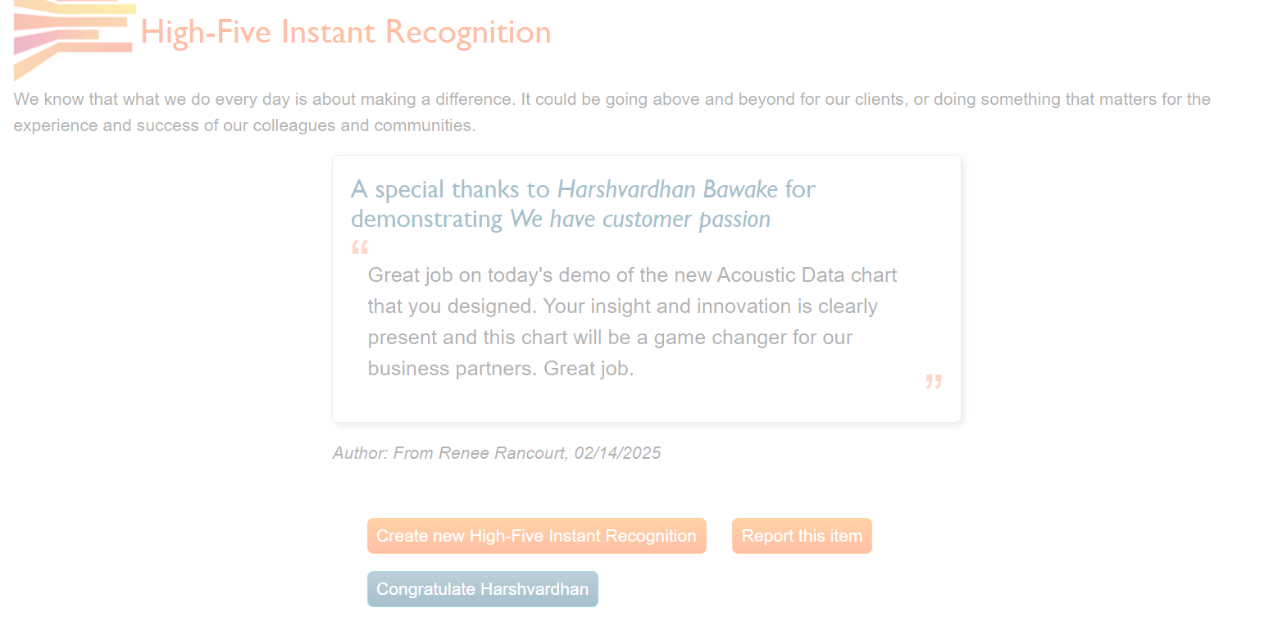
Client Feedback
Notes:
Client Feedback

